Slide 1
IT Enable Services
International Credit Information Limited

Slide 2
What is IT enabled Service (ITES)?
IT enabled services, also called web enabled services covers the entire range of operations which exploit information technology for improving efficiency of an organization. (IT knowledge portal 2018, accessed 22 March 2018 http://www.itinfo.am/eng/it-enabled-services/)
OR
information technology that enables the business by improving the quality of service is IT enabled services. (IT knowledge portal 2018, accessed 22 March 2018 http://www.itinfo.am/eng/it-enabled-services/)
Key IT Enabled Services
Portals
Data Centers
ERP (Enterprise Resource Planning)
Etc.

Slide 3
About International Credit Information Limited (ICIL)
ICIL-Pakistan is major Business / Credit Information Database Company. Its database contain almost all public companies , majority of registered and operative private companies and registered partnership firms engage in large scale manufacturing / SMEs , commercial and Service businesses.
ICIL provides a range of services including IT based verification / background screening services and business information services to Pakistan banking industry, corporate sector and the exporter’s community.

Slide 4
IT based verification / background screening services overview
ICIL re-engineered traditional paper based verification to make it IT enabled service. GPS and Image capturing, real time data sync and database maintenance are value additions done by ICIL.
A portal has been developed to provide IT based verification / background screening services.
Portal gets real time data from field using an android based client application.
Real time data is shared between portal and client (android app) using internet.
Database maintained in our datacenter.

Slide 5
IT based verification / background screening services Process Flow
Inquiries are entered into portal by customer.
Inquiries are assigned to relevant branches by system automatically.
Branch supervisor assigns inquiry to Field Investigation officer (FIO) using portal.
Inquiry is conducted in field by FIO and completed.
After completion inquiry is synced from field using internet. As soon as inquiries are synced they reflect on our portal in real time.
Client view and print reports from our portal.

Slide 6
IT based verification / background screening services Key Features
Real time data sharing
Capturing GPS Location
Capturing Images
Detailed MIS Reporting
Dashboard
Easily accessible web portal
Data encryption

Slide 7
IT based verification / background screening services Process Flow Diagram
Inquiry creation
Auto Sorting
Inquiry assignment to FIOs
Inquiry conducted in field
Data synced with server
Report downloaded from portal

Slide 8
Business Information Services Overview
These services are provided to financial and corporate institutes. Generic scope of these services include gathering of relevant information from different sources, verification of provided information and present findings.
Application Flow
Inquiries are created by customers using ICIL’s portal.
Inquiries are forwarded to relevant branches by system automatically.
Inquiries are processed and completed.
Data entered / uploaded into the portal.
Reports become available to clients in real time.
Client view / download report from portal.

Slide 9
Business Information Services Key Features
Maintaining Database
Real time data sharing
Data security
Detailed MIS Reporting
Easily accessible web portal

Slide 10
Business Information Services Process Flow Diagram
Inquiry creation on Portal
Auto Sorting
Inquiry Processed
Data entry / uploading in system
Report available on portal
Report downloaded from portal

Slide 11
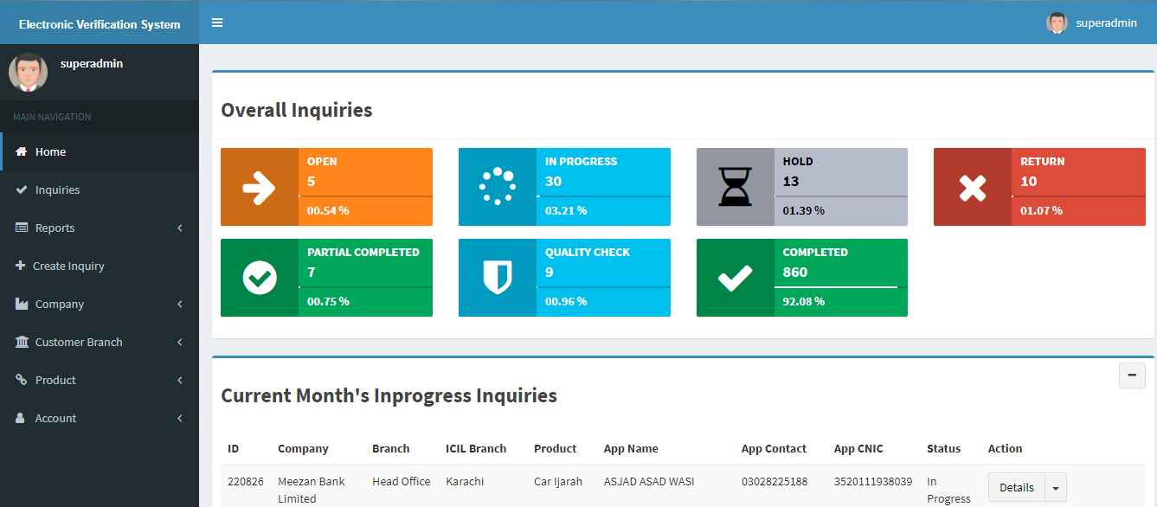
Screen Shoots (Dashboard)

Slide 12
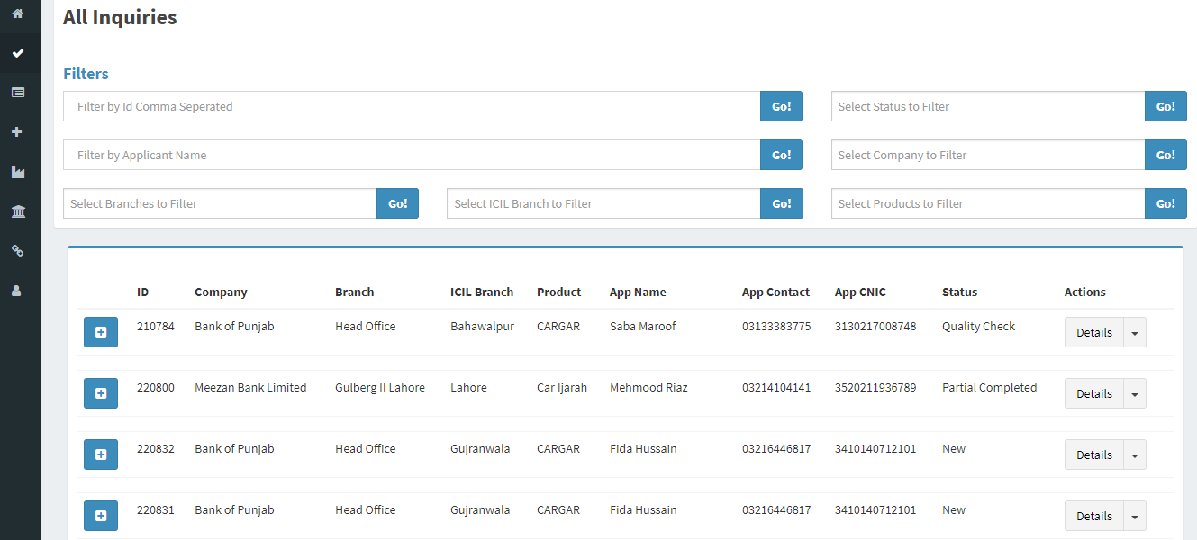
Screen Shoots (Inquiries)

Slide 13
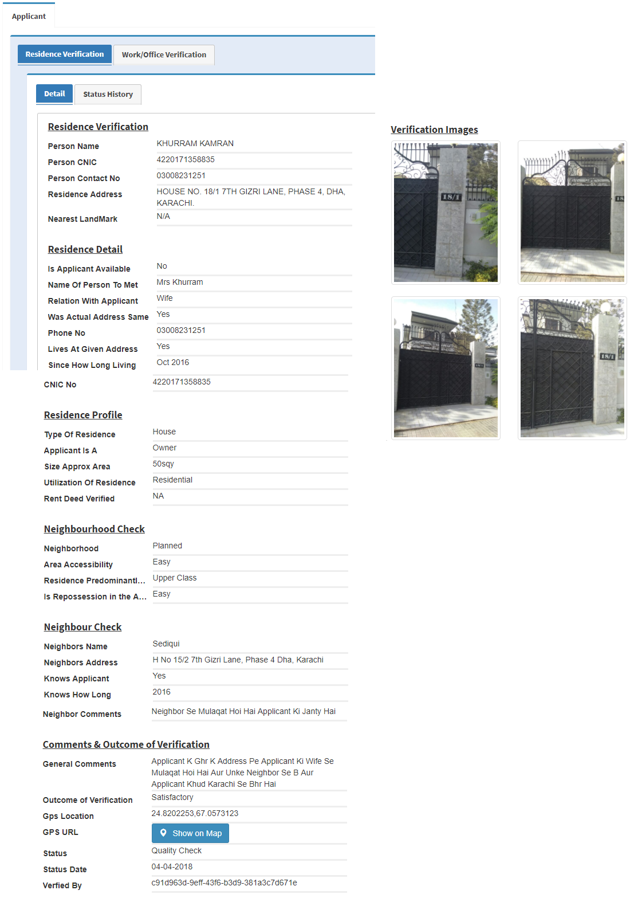
Screen Shoots (Inquiry Details)

Slide 14
That’s all from us. Thank you very much for your time.

