Slide 1


Slide 2

Global Business Bridge
In the age of rapid global economic integration no country can survive in isolation from the rest of the world, ICIL Global Business Bridge links companies across the world to do business.
Due to global economic integration, doing business globally is becoming riskier day-by-day. ICIL also acts as a local & global risk mitigator.

Slide 3
ICIL Pakistan comprises of following companies
ICIL [International Credit Information Ltd]
ICIL Ltd
ICIL Technologies Ltd
Incorporated and started business in March 1998
Auditors : KPMG
Head Office in Karachi and Branch Offices in 16 cities
ICIL is the member of International Association of Credit & Collection Professionals & National Association of Background Screening Companies

Slide 4
BOARD OF DIRECTOR
Humayun Mufti FCA (England/Wales) – An entrepreneur with industrial management background. Former share holder & CEO of Ghandara Nissan Ltd, Honorary Consul Republic of General Slovenia.
Dr. Adil S. Mufti PhD (University of London) – An entrepreneur with industrial management background. Former CEO of General Tyres & Rubber Ltd
Amer Aziz Saiyied Advocate. currently legal advisor to the Banking Ombudsman. Former company Secretary & Legal Counsel Lever Brothers Pakistan Ltd.
Arif Mufti (FCA) – Ex Chairman American Life Insurance Company Ltd & MetLife Insurance ( ALICO/MetLife)
Yasser Mufti – Head of IT& CEO of ICIL Technologies Ltd B.Sc. & M.Sc. from Queen Mary College – University of London.
Babar Mufti CEO – Economist B.Sc. & M.Sc. London School of Economics& Political Science – (University of London).
Syed Azfar Baqvi – MBA & CA- Group Chief Operating Officer Former CEO of a leading financial Institution

Slide 5
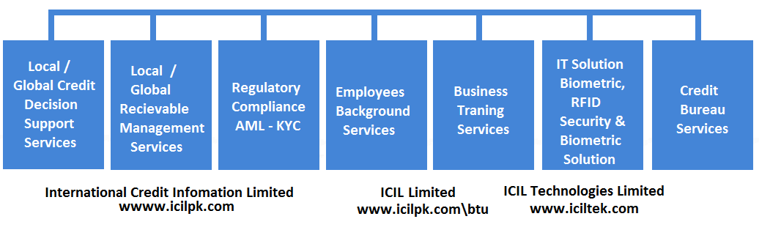
ICIL-Global Business Bridge have 10 business units, Five are housed in www.icilpk.com & five are housed in www.iciltek.com

Slide 6
It maintains Pakistan’s largest business information database of most public, private limited companies & registered partnership firm. ICIL also has access to the business information databases in most countries of the world through its partners of different countries.
ICIL team of professionally qualified business analysts based in ICIL branch network updates its business information database.
Using this database, ICIL professional team tailors credit decision support report as per SBP prudential requirement.
ICIL has pool of academically qualified & professionally experience H.R including IT graduates, Economist, MBAs. Chartered Accountants , ACCA
It has Branch Offices in all major industrial cities of Pakistan

Slide 7
Local & Global Business Information Service
Consumer Banking Finance
IER, Verification
SME’s Banking Finance
Cash flows, Financial information, Credit worthiness (ability, willingness), Reputation Check (suppliers, customers, competitors, court notices), Existence (legal doc’s, visit, third party check)
Corporate Banking Finance
Search Report for charge including Ranking, Charge Registration, Market Reputation
Banking
Local Business Information Report
SME Credit Report
Income Estimation Report
Market Check Report
Registered Charge Report
Charge Registration
FMCG Co’s
Corporate Due diligence (distributor’s, vendors, franchise’s, supplier’s)

Slide 8
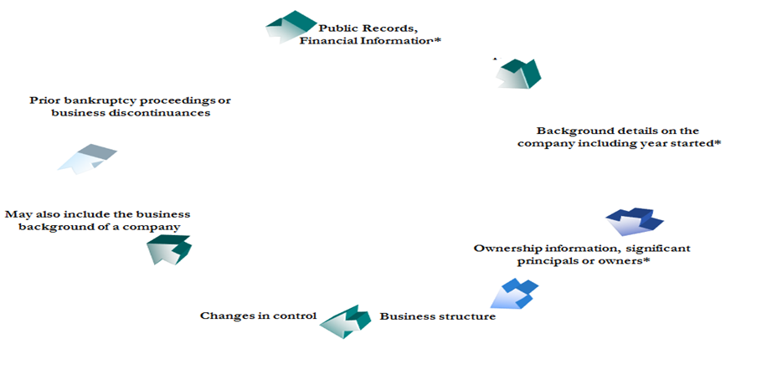
Local & Global Business Information Service
Global Credit decision Services
Against Exports & Imports to ascertain the genuineness of the counter party
A Global Credit Decision Support Report

Slide 9
Local & Global Debt Collection Service
Local Debt Collection Service
Outsourcing of Receivable Collection Unit
All Receivable recovered
Receivable Management
Considered difficult to recovered
Crossed certain criteria, 120+, etc
Defaulted customers
Debt Collection
Asset Repossession
Recovery through taking back of Assets
SBP Guidelines
Asset Tracing
Identification of property of defaulted Directors (their dependents)

Slide 10
Global Debt Collection Service
Doing Business globally is becoming riskier day by day.
Approx. 40 % of Pakistan Export is without LC which is a Global Credit Risk.
ICIL Global RMS/Debt Collection service is provided though:
RMS Annual Membership - It entitle subscriber to have access to ICIL global collection network,
subscriber can export unlimited consignment anywhere in the world. At the end of credit period
the exporter can either extend credit period or ask ICIL partner to collect the outstanding export
processed.
Terms: NO COLLECTION - NO COMMISSION
During the membership the exporter can get one BIR on its foreign buyer

Slide 11

Business Training Services (BT)
ICIL-BT conducts open enrolment course & in-house training courses
.
ICIL-BT past & current training courses are given on its website. (www.icilpk.com\btu)
ICIL- BT have large number of local & foreign trainers on it panel.

Slide 12

ICIL –Regulatory compliance Service
ICIL KYE Service involves Background Screening i.e., Degree Verification from local as well as International Universities / Educational Institutions, Employment Check, Reference Check and Address Verifications.
ICIL provides Employers based in foreign countries get Degree Verification of Pakistani Candidates from Local universities/ institutions
ICIL also provides Pakistan Employers, Degree Verification of foreign & Pakistani Candidate from the foreign universities.

Slide 13
ICIL AML-KYC Service
ICIL offers
LexisNexisworldCompliance On-Line Tool
LexisNexis ; Bridger Insight® XG
AML Transaction Monitoring system
ICIL AML-KYC Helps
Its banking customers to meet SBP-AML/CFT Regulation
Insurance companies & Capital Market to meet SECP Requirement
Corporate Sector to follow Pakistan Anti-Money Laundering Act 2017

Slide 14
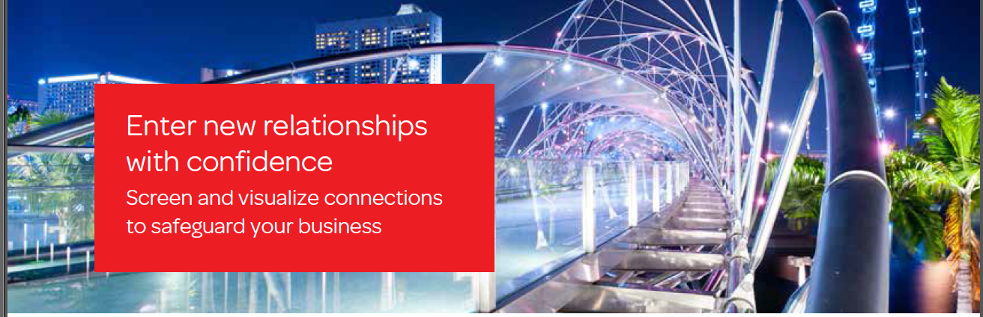
ICIL AML-KYC Service (continue)
LexisNexisworldCompliance online tool.
Enables you to manually screen prospective clients and perform enhanced due diligence using one of the industry’s most extensive identity databases. Our profiles are updated daily by our global network of analysts to produce recent and encompassing identity information.

Slide 15
ICIL AML-KYC Service (continue)
LexisNexis ; Bridger Insight® XG
Bridger Insight® XG is designed to conduct due diligence, comply with global regulations and reduce fraud risks through a single platform. Regulatory fines, a tarnished corporate image, and a loss of customer confidence are inevitable consequences of an ineffective AML solution. Bridger Insight® XG was designed to conduct thorough due diligence activities and help comply with global anti-money laundering (AML) regulations, all with unprecedented efficiency through a single, intuitive platform. With a single transaction request, you can investigate an individual or business and access a penetrating, transparent perspective that encompasses global sanctions and enforcements, politically exposed persons (PEPs) and associates, adverse media and state-owned companies.

Slide 16
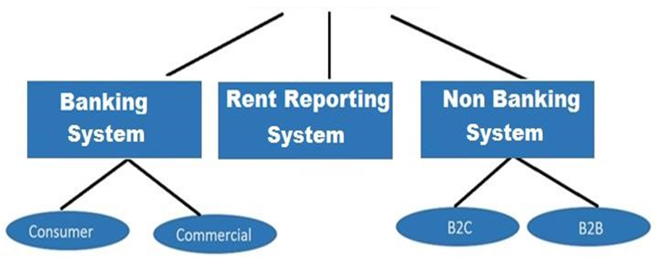
Credit Bureau Service
Banking system will be operative after SBP License.

Slide 17
Credit Bureau Service (continue)
ICIL Credit Bureau provides payment history & default in payment if any, of the individuals & companies who either borrow from banks, or buy good/services on credit or on hire purchase from companies
The user’s (Bank & companies who sell on credit) have to provide updated payment records & status of default of their debtors. Payment history records have to be as per ICIL Credit Bureau specification. Users can directly load records in to credit bureau system.
The users are required to sign a subscription agreement with ICIL Credit Bureau, where they have to give authority to put their debtor’s payment history into credit bureau database
The Users can check through credit report the payment history of prospective or existing customers / borrowers with other credit granters.
Users can check total indebtedness of a borrowers / customers.
Credit bureau helps you to identify borrower to have defaulted with other bank/companies or identify good borrower.
The Credit Bureau does not have any right to alter or modify ant record, it uploads the data submitted by a contributor (subscriber) on as it is basis.

Slide 18
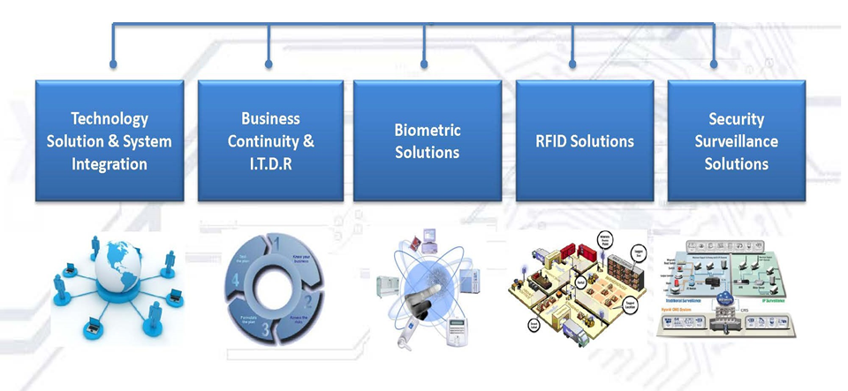
ICIL Technology Service

Slide 19

















Global Partnership

Slide 20












Major Banking Customers

Slide 21
















Corporate Customers

Slide 22










KYE Customers (Employees Degree/Educational Certificates Verifications, PREVIOUS EMPLOYMENT CHECK , CNIC Verification)

Slide 23
CONTACT INFORMATION
MAIN HEAD OFFICE
C-6, Ittehad Lane 2, Phase VI, DHA, Karachi.
Tel: +92 21 35246551 – 58
Fax: +92 21 35246559
Email: umair@icilpk.com tasneem@icilpk.com
REGIONAL OFFICE
21 –K, Model Town Lahore.
Contact: M. Jawad
Tel: +92 42 35929466 - 71
+92 42 35929473 - 76
Email: cslhr@icilpk.com
MULTAN
Office No. 23/24 , 2nd Floor Abdullah
Center LMQ Road
Contact : Ejaz Ahmed
Tel : +92 61 4513004, 4545435
Fax : +92 61 4517440
Cell: 0300-9439433
ISLAMABAD
Office #: 2-A, Sheikh Market,
I-10/1, Islamabad.
Customer Service
Tel: +92 51-4443781-82
Cell: 0345-9001886
Email : zahid@icilpk.com
FAISALABAD
P-64, 2nd Floor Chenab Market, Susan Road, Madina Town, Faisalabad.
Contact: Muhammad Yasin
Tel : +92 41 8737312 – 13
Cell: 0321-6625358
Email: yasin@icilpk.com
csfsd@icilpk.com
GUJRANWALA
Office # 2, 4th floor, Trade Center G.T Road Gujranwala.
Contact :H.A Saboor ,M. Usmain
Tel : +92 55 3731791
Fax : +92-55 3253390
Cell: 0300-6445479
Email: gujranwala@icilpk.com
HYDERABAD
Office #. 142/16-A, 4th Floor, Anam Plaza, Defence, Hyderabad.
Contact : Abdul Farooq Shahan
Tel : +92 22 2783126
Fax: +92 22 2780805
Cell # 0332-8200877
Email: Sup_verihyd@icilpk.com
QUETTA
Office #. 1260 Street No. 9 Faisal
Town, Brewery Road Quetta
Contact : Adnan Yousuf
Cell: 0321 8012987
Cell: 0333 7106992
Email: quetta@icilpk.com
PESHAWAR
T-40, Yasser Colony, Hussain Chowk
Sirbuland Pura, Haji Camp, G.T.Road
Contact : Mohammed Zahid
Tel : +92 91 2261682
Fax : +92 91 2261685
Cell: 0345-9001886
Email: zahid@icilpk.com

Slide 24
CONTACT INFORMATION
SIALKOT
Office No. 22 2nd Floor, Warraich
Mansion,Paris Road.
Contact: Hafiz Abdul Saboor
Tel : +92 52 4292435
Fax : +92 52 4266335
Cell: 0300-8612627
Email: icilskt@pakbizinfo.com
JHANG
Office No. 2, 2nd Floor, Al-Hafeez
Market, Ayub Chowk,Faisalabad Rd.
Jhang Saddar.
Phone : +92 47 7623394
Email: ejaz@icilpk.com
LARKANA
Near Raza Bhatti Cloth House Dari
Mohalla Larkana
Contact : M.Aamir Shaikh
Cell: 0321-3104202
Cell: 0321-3104202
SARGODHA
FF-130, Al-Rehman Trade Centre
University,Road Sargodha
Contact : Khurram Shehzad
Cell: 0345-7716916
Email: ejaz@icilpk.com
SUKKUR
Office No. 11, Alfa Tower, First Floor
Opposite District Jail, Shalimar,
Sukkur.
Contact : M.Aamir Shaikh
Cell: 0321-3104202
Email: icilsukkur@icilpk.com

Slide 25
Websites
www.icilpk.com
THANK YOU

