Slide 1

AML - KYC SERVICE
Compliance is NOT an Option!

Slide 2
Compliance is NOT an Option!
AML

Slide 3
At Stake is…….
Institution’s Reputation – worldwide
Business
Direct Financial losses (Penalties, fines)
Customer attritions (customers feeling Insecurity)
Share Prices
ETC

Slide 4
ML Risk & Solution
Like any other Operational Risk, ML Risk also can NOT be eliminated completely due to;
Nature of Risk – an intent to defraud
Solutions available – limited options
Costs involved
Therefore, ML Risk can only be reduced to an “ACCEPTABLE” level

Slide 5
ML Risk & Solution
What is an “acceptable” Solution in the eyes of regulators/monitors??
A review of the verdicts given by the regulators / monitors, does reveal their expectation of the Global AML regime compliance

Slide 6
Results of Non-compliance could be ………….
Institution | Amount IN USD | Agency
Bank Hapoalim Ltd Israel | Sanction USD $2.1 Million | FINCEN, SEC
The main infringements cited in the Inspection Report derived from inadequate preparation mainly in the following:
Failure to obtain or maintain declarations on beneficiaries in accounts.
Management of accounts for communal services and advocates’ accounts for their clients not in accordance with the requirements of the Order.
Failure to report unusual activities.
Failure to freeze accounts for which the customers’ identification particulars were not yet completed.
Late submission of reports to IMPA.

Slide 7
Results of Non-compliance could be ………….
Institution | Amount IN USD | Agency
Royal Bank of Scotland Group United Kingdom | Sanction USD $9 Million | FSA UK
The Financial Services Authority (FSA) fined members of the Royal Bank of Scotland Group (RBSG) £5.6m for failing to have adequate systems and controls in place to prevent breaches of UK financial sanctions.
During 2007, RBSG processed the largest volume of foreign payments of any UK financial institution. However, between 15 December 2007 and 31 December 2008, RBS Plc, NatWest, Ulster Bank and Coutts and Co, which are all members of RBSG, failed to adequately screen both their customers, and the payments they made and received, against the “Sanctions list”.
This is the biggest fine imposed by the FSA to date in pursuit of its financial crime objective.

Slide 8
Results of Non-compliance could be ………….
Institution | Amount IN USD | Agency
Pamrapo Savings Bank, SLA | $5 M Forfeiture, $1 M CMP | OTS, DOJ, FinCEN
" "According to the criminal information filed in U.S. District Court in Trenton, N.J., Pamrapo Savings Bank conspired with others to conceal its customers’ illegal or suspicious activities by failing to file currency transaction reports (CTRs) and suspicious activity reports (SARs) and by willfully failing to maintain adequate anti-money laundering programs. Pamrapo Savings Bank admitted that it willfully violated the Bank Secrecy Act to avoid the expenses associated with compliance, despite federal and state banking regulators telling Pamrapo Savings Bank as early as 2004 that its Bank Secrecy Act and anti-money laundering programs contained serious and systemic deficiencies in critical areas required under the law.

Slide 9
Results of Non-compliance could be ………….
Institution | Amount IN USD | Agency
Wachovia Bank, NA, Charlotte, NC | $110M Forfeiture/CMP; $50M CMP; C&D | FinCEN, DOJ, OCC
Failed to implement adequate policies, procedures, or monitoring controls governing the repatriation of USD
Failed to conduct monitoring of high volumes of monetary instruments
Failed to appropriately monitor traveler's checks
Failed to appropriately institute risk-based monitoring of the Bank's foreign correspondent customers
Failed to file timely SARs involving suspicious transactions conducted through certain foreign correspondent accounts at the Bank; after conducting a voluntary lookback, the Bank filed over 4,300 SARs involving suspicious transactions conducted through the Bank by CDCs and high risk foreign correspondent customers.
Failed to adequately report cash structuring activity from review of alerts generated in the Bank's Financial Intelligence Unit

Slide 10
Results of Non-compliance could be ………….
Institution | Amount IN USD | Agency EU
Eurobank, San Juan, PR, (now part of Oriental Bank & Trust) | $25K CMP | FinCEN, FDIC
Breakdowns in the Bank's anti-money laundering program caused the Bank to fail to effectively identify and report transactions that exhibited indicia of money laundering or other suspicious activity, relative to the types of products and services offered by the Bank, the volume of its business, and the nature of its customers.

Slide 11
Results of Non-compliance could be ………….
Institution | Amount IN USD | Agency EU
Royal Bank of Scotland (formerly ABN AMRO Bank) | $500 M forfeiture | DOJ
According to the criminal information filing, the bank stripped information from funds transfer instructions and other transactions to disguise involvement of OFAC-sanctioned parties or to facilitate OFAC-prohibited transactions, and deliberately ignored its [OFAC and BSA] compliance obligations

Slide 12
Classification of Institutions Defaulted……
Those who wanted to earn quick money using illicit means and crossed limits
Those who were caught unprepared
Tools and means employed were insufficient
Personnel were not trained
Appropriate reviews of the program in place, were not made

Slide 13

Protect your Institution with the Best Solution Available
Compliance is NOT an Option!
Compromises in compliance lead to untoward situations!

Slide 14
AML Services Offered by ICIL
Enhanced Customer Due Diligence Service
Watch List

Slide 15
ICIL Enhanced Due Diligence Service
Know your customers’
Whereabouts ; business, living
Income earning activities
Reputation in the Society
Preoccupations/background
Our Service’s Hallmark
Coverage throughout Pakistan
Confidentiality Respected
Timely delivery
Reasonably Priced

Slide 16
“Watchlist”

Slide 17
RDC Watchlist Global Research Team
Global Research centres
Sanction list research carried out in all 5 centres
Ensures 24 hour monitoring of the sanction list content
“Follow the Sun” model.
Large list updates are being progressed by all centres
Our clients benefit from this constant monitoring
Proactive and reactive research methodology
Over 40 languages spoken fluently
Fluency in English for all staff

Slide 18
Focus on quality
Dedicated quality team focused on data integrity, conformity with data protection law and quality management
Watchlist content regularly monitored to ensure that it meets four key quality criteria
Accuracy – the individual’s details are correct
Complete – all publicly available information fitting the Watchlist criteria is entered on the record
Up to date – the information is current against our refresh targets
Clear and consistent categorisation of all records on database
Monthly monitoring of all researchers inputs based on:
Precision – checking the accuracy of information in records
Recall – What is not in the record that could have been
Other proactive checks include - Audits by categories, duplicate checking - inverted names, by date of birth,.

Slide 19
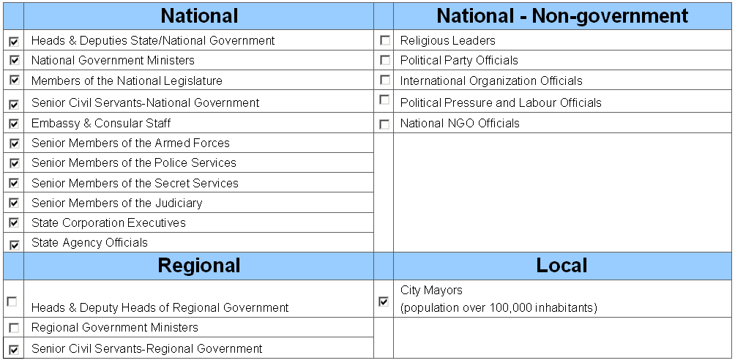
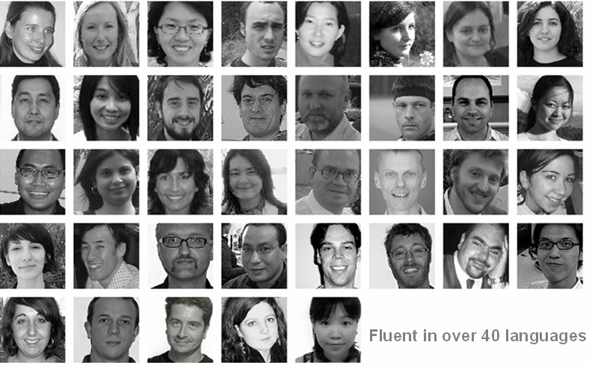

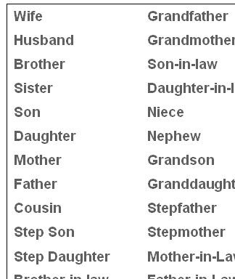
What makes RDC Watchlist unique?
Trusted “enterprise wide” by the worlds leading financial institutions
Our coverage definitions & research methodology
Cleanly formatted and structured data
The skills and standards of our dedicated global research team
Access to unique information resources

Slide 20
Your risk based approach is about where you draw the line
 | Sanctions & Crime | PEPs
High Level Risk Low Level Risk | SANCTIONS Entities with Links to Terror Financial Crime Drug trafficking | Senior Level PEPs
 | Petty Crime: street drugs dealers, shoplifters Traffic / Parking Fines | Junior and Middle level officials, deputy mayors, immigration, planning officials. Pest control
10,000
Watchlist
500,000
1,000,000
Triangle represents matches requiring investigation
B

Slide 21
What is Watchlist?
Senior Politically Exposed People (PEPs)
Relatives & Close Associates
Global coverage of sanctions list, law enforcement and other official lists
High profile persons of Special Interest (negative media)
Financial crime
Organised crime
Terror/Terrorist financing
Corruption
Trafficking/smuggling/counterfeit
War crime
A to global media
Users of watch List

Slide 22
The Watchlist PEP Definition
NATIONAL | NATIONAL - NON-GOVERNMENT
Heads & Deputies State/National Government | Religious Leaders
National Government Ministers | Political Party Officials
Members of the National Legislature | International Organization Officials
Senior Civil Servants-National Government | Political Pressure and Labour Officials
Embassy & Consular Staff | National NGO Officials
Senior Members of the Armed Forces
Senior Members of the Police Services
Senior Members of the Secret Services
Senior Members of the Judiciary
State Corporation Executives
State Agency Officials
REGIONAL | LOCAL
Heads & Deputy Heads of Regional Government | City Mayors
Regional Government Ministers | (population over 100,000 inhabitants)
Senior Civil Servants-Regional Government
EU Member of European Parliament
Back

Slide 23
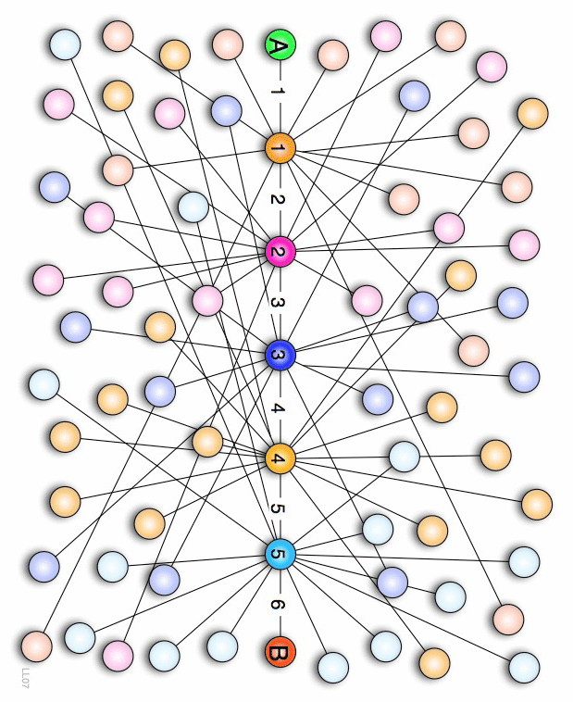
Coverage of Relatives and Close Associates
Wife | Grandfather | Business Associate
Husband | Grandmother | Friend
Brother | Son-in-law | Financial Adviser
Sister | Daughter-in-law | Legal Adviser
Son | Niece | Colleague
Daughter | Nephew | Agent / Representative
Mother | Grandson | Associate
Father | Granddaughter | Political Adviser
Cousin | Stepfather | Unmarried Partner
Step Son | Stepmother | Same sex spouse
Step Daughter | Mother-in-Law | Owner / Shareholder
Brother-in-law | Father-in-Law
Sister-in-law | Aunt
Uncle
Identify your clients’ networks that could put your institution at risk
Back

Slide 24








Official List Coverage
Global coverage of over 650 lists
Law Enforcement and other official Lists from all over the world
Back

Slide 25
High Profile Criminals - Special Interest Coverage
PEP’s or other persons accused, arrested or convicted of serious crimes:
Intelligence gained from global media
Scanning almost 2,000,000 articles ICIL partners archives
Profiles contain as a minimum:
Financial Crime | War Crime
Organised Crime | Corruption
Terror/Terrorist Financing | Trafficking/Smuggling/Counterfeit
Clear Categorisation
Name, Country of Residency and/or Citizenship
Profile note written to standards
Source linking to the data source news archive
Back

Slide 26


